Slide 1

ROTARY CLUB SATÉLITE DO SANTO ANDRÉ ALPHA
Diversity as a Driving Force
for Inclusion
Supported employment for adolescents and young people with disabilities.
Focus area: Community Economic Development

Slide 2
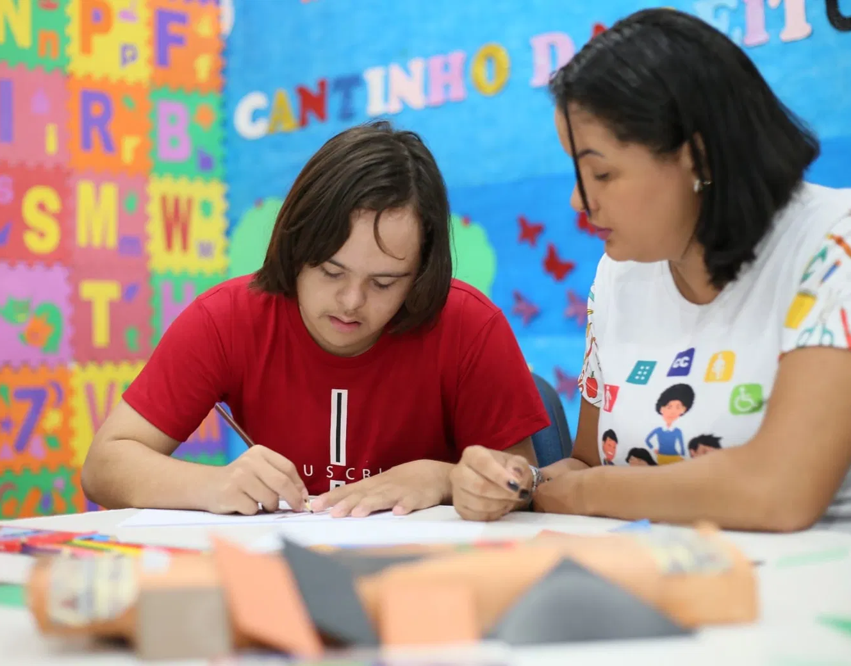



Inclusion that fosters autonomy and decent job
The program expands opportunities for skills training, employability as social participation for young people with disabilities in the ABCDMRR region.
Accessible professional training
Preparation for real job opportunities.
Supported Employment
Entry into the open market with personalized support.
Integral Accessibility
More inclusive physical, digital, and pedagogical environments.
Inclusive capacity to learn, work, and belong
02

Slide 3




Priority target audience and social impact
Adolescents and young people aged 14 to 29 residing in the ABCDMRR region, with physical, mild intellectual, or hearing disabilities.
150
120
Young people qualified through the program
Entry into the labor market
85%
≈450
Retention after 12 months
Family members and support network reached
Results underpinned by qualification, accessibility, and individualized support.
03

Slide 4




Supported Employment: from Profile to Retention
The young person is at the center of a journey involving paid work in an inclusive environment with ongoing support.
1. Welcoming and mapping
2. Prepare and qualify
3. Move close to work
4. Insert and track
Vocational profile,
interests and support needs.
Professional, social and autonomy-related competency
Analysis of positions, awareness-raising, and business coordination.
Job coaching, reasonable accommodations and retention.
Support gradually decrease as the young person gains independence at work.
04

Slide 5

Partnerships that enhance inclusion
Specialized services and pedagogical investments underpin the project’s service capacity.
Instituto Jô Clemente
BRL 104.900
US$ 20.569
Inclusão Corporativa
BRL 64.800
US$ 12.706
Assessment of physical, administrative, and qualification needs.
Training for staff and educators on the inclusion of people with disabilities.
Sinal Link Acessibilidade
BRL 14.158
US$ 2.776
Educational Materials
BRL 29.242
US$ 5.734
Digital accessibility compliance and technical support for inclusive features.
Books, psychomotor materials, and inclusive pedagogical resources.
Exchange rate of august 2026: BRL 5,10 per US$
05

Slide 6




Accessibility and foundational learning
Four integrated fronts increase the capacity to welcome, teach, and support each young person with quality.
Specialized diagnosis
Team building
Barriers identification and definition of physical, administrative, and staffing adaptations.
Inclusive practices for staff and educators, focusing on service and learning.
Digital accessibility
Educational Materials
Digital resources, content, and interfaces capable of meeting diverse access needs.
Books, psychomotor materials, and inclusive pedagogical resources.
Inclusion becomes sustainable when the institution learns to remove barriers continuously.
06

Slide 7
Consolidated budget: R$ 230.148,00 - US$ 45.127
Budget Composition | Local Curency (BRL) | August 2026 (US$)
Instituto Jô Clemente | 104.900 | 20.569
Inclusão Corporativa | 64.800 | 12.706
Sinal Link Acessibilidade | 14.158 | 2.776
Education Materials | 29.242 | 5.734
Subtotal before contingency | 213.100 | 41.784
Contingency tax | 17.048 | 3.343
PROJECT TOTAL | 230.148 | 45.127
LOCAL CURRENCY TOTAL
BRL 230.148
ROTARIAN DOLLAR EQUIVALENT (*)
US$ 45.127
(*)August 2026: R$ 5,10 per US$
07

Slide 8



Currency contingency protects execution
The 8% reserve mitigates exposure to dollar fluctuations regarding funds subject to international benchmarks or disbursements.
Execution protection
Prevents disruptions caused by unforeseen exchange rate fluctuations.
.
8%
Foreign exchange contingency reserve
Controlled use
Mobilization only with justification and documentary record.
Base: BRL 213.100,00
Reserve: BRL 17.048,00
Accountability
The reserve will be tracked in the project’s financial reports.
Total: BRL 230.148,00
REFERENCE EQUIVALENT
US$ 45.127
The Contingency does not replace financial control. It preserves the ability to meet approved deliverables.
08

Slide 9
Quarterly monitoring transforms resources into results
Simple indicators, verifiable methods, and periodic reports guide project management.
01
Prepared team
02
Institutional capacity
Number of trained staff members and educatores.
Method: lists, certificates, and reports.
Physical, digital and administrative adjustments implemented.
Method: checklists and direct observation
03
Qualified students
04
Productive inclusion
Participation and professional skills development.
Method: records and regular assessments.
Entry into and retention in the labor market.
Method: documentation and monitoring
.
Frequency: quarterly • Evidence: documentation, reports, practical assessments, and direct observation
09

Slide 10
Four steps for implementation
A 24-month journey connects diagnosis, training, productive integration, and the generation of results.
M1
M3
M6
M12
M18
M24
1. Preparation
Diagnosis
Months 1 to 3
2. Mobilization
Profile
Months 4 to 6
3. Qualification and integration
Training, Employers, and Supported Employment
Months 7 to 18
4. Consolidation
Monitoring and evaluation
Months 19 to 24
Rotary participation in governance, partnerships, monitoring, and accountability.
10

Slide 11

Diversidade Protagonista na Inclusão
We appreciate your support and attention.
Transparency note
The financial figures in this presentation were provided by the Rotary Club Satélite Santo André Alpha and consolidated into the revised budget.
Contacto Rotary Club Satélite do Santo André Alpha
Ana Claudia Vazelin Bretas
Mobile phone: (5511) (5511) 98284-8684
E-mail: acvbretas@uol.com.br
12

Slide 12
Next step: approve the revised execution
An investment structured to create inclusive capacity and real job opportunities.
REVISED BUDGET
R$ 230.148
US$45.127
1
Formalize partnership
Agreements, scopes, and delivery schedules.
2
Provide a detailed breakdown of the calculation
Specify the other projected execution costs.
Accessibility, skills development, and materials for sustainable productive inclusion.
3
Initiate the institutional diagnosis
Start of the program's implementation.
11

